Slide 1
British Culture

Slide 2
Questions for Thought
Can you think of any examples of how we are influenced by the British Culture?
What do you know about the British Culture?
As we discuss different aspects of British culture, can you see any similarities or differences with our own Taiwanese culture?

Slide 3
National Identity
English (specifically England) =/= British (generally Great Britain)
United Kingdom - England, Scotland, Wales and Ireland
Britain = England, Scotland, and Wales
National Flag = England (St. George) + Scotland (St. Andrew) + Ireland (St. Patrick)
= + +

Slide 4
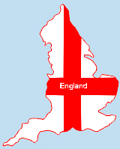
England
Land:
South: mostly low-lying land with hills
and agricultural land
North: mostly covered in moorland and
mountains.
Capital: London (also of the U.K.)
History: nearly 2,000 years beginning
with the arrival of the Romans soon after their invasion of Britain in AD43.

Slide 5
Monarchy
Queen’s birthday
21 April 1926: actual birthday
Summer birthday since 1805: normally held on the second Saturday in June
The British Royal Family’s Surname: Windsor
Changed from Saxe-Coburg-Gotha to Windsor in 1917
Reason: In 1917, King George V renounced all the German
titles belonging to him and his family and adopted the name of his castle, Windsor, because of WWI and anti-German sentiment
Duties: Head of State (representative), Head of the Armed Forces (declare war), Head of the Church of England (appoints bishops and archbishops), Government Duties (signature needed), Represents the Nation (at times of sorrow), Royal Garden Parties, Visits (various places)

Slide 6
Queen Elizabeth II (1926)
The Queen's sons and daughter
Charles Prince of Wales | Anne Princess Royal | Andrew Duke of York | Edward Earl of Wessex

Slide 7
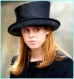
The Queen's Grandchildren
Prince William of Wales (1982) | Peter Phillips (1977) | Princess Beatrice of York (1988) | Lady Louise Windsor (2003)
Prince Harry of Wales (1984) | Zara Phillips (1981) | Princess Eugenie of York (1990)

Slide 8
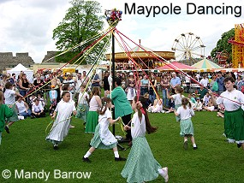
Festivals
May Day Celebrations: Maypole Dancing
Origin: the Roman festival of Flora, goddess of fruit and flowers
Celebrate the coming of summer after a long winter
A time for love and romance

Slide 9
Etiquette in England
Do:
Stand in line
Take off your hat when indoors
Cover your mouth when yawning or coughing
Shake hands
Drive on the left side of the road
Don’ts:
Greet people with a kiss unless it’s family or close friends
Talk loudly in public
Stare at others
Ask personal and intimate questions

Slide 10
Tea Customs
Afternoon Tea:
Served at 4 in the afternoon
Tea, coffee, freshly baked scones, tea sandwiches, and assorted pastries
This became popular about one hundred and fifty years ago when rich ladies invited their friends to their houses for an afternoon cup of tea
High Tea:
Served at 6 in the evening
Scones, cakes, buns or tea breads, cheese on toast, toasted crumpets, cold meats and pickles or poached eggs on toast
British working population did not have afternoon tea, only a midday meal and a meal after work
a.k.a dinner or supper
(Source)

Slide 11
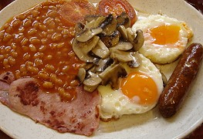
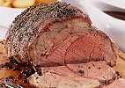
Food
Traditional English Breakfast (Full English)
eggs, bacon, sausages, fried bread, baked beans and mushrooms
Traditional English Dinner
meat and 2 vegetables with hot brown gravy
Sunday Roast Dinner
roast meat, two vegetables and potatoes with a Yorkshire pudding
Lunch – dinner (the main meal)
Dinner – tea, supper

Slide 12
Sports
England’s national sport: cricket
Most popular sport: soccer (football)
Rugby: this sport used to be played by the rich upper class only
Tennis: Wimbledon
Traditionally, visitors eat strawberries and cream while watching the game
Polo: brought to Britain from India in the 19th Century by army officers
Boxing Day Hunts: Traditionally it is a day for fox hunting
Boxing Day is the following day after Christmas Day
18 February 2005: hunting with dogs became a criminal offence

Slide 13
Superstitions
Good Luck:
Lucky to meet a black cat
Lucky to touch wood
Lucky to find a clover plant with four leaves.
A right way up horseshoe over the door brings good luck (like a “U”)
Catch falling leaves in Autumn and you're have good luck.
Bad Luck:
Unlucky to walk underneath a ladder
Seven years bad luck to break a mirror
Unlucky to see one magpie, lucky to see two, etc.
Unlucky to spill salt. If you do, you must throw it over your shoulder to counteract the bad luck
Unlucky to open an umbrella in doors.
The number thirteen is unlucky
Friday the thirteenth is a double unlucky day because Jesus was crucified on a Friday.
Unlucky to put new shoes on the table
Unlucky to pass someone on the stairs

Slide 14
Vocabulary
Agricultural 農業的
Moorland 荒野;高沼地
Invasion 入侵,侵略
Surname 姓
Renounced 聲明放棄;拋棄
Titles 頭銜;稱號
Adopted 被採用的
Sentiment 感情,心情;情操
Duties職責;職務
Pastries 酥皮點心
Cricket 板球
Polo 馬球
Criminal 犯罪的,犯法的
Offense 過;犯法(行為);過錯

Slide 15
Reference
British Life and Culture
http://projectbritain.com

